Slide 1
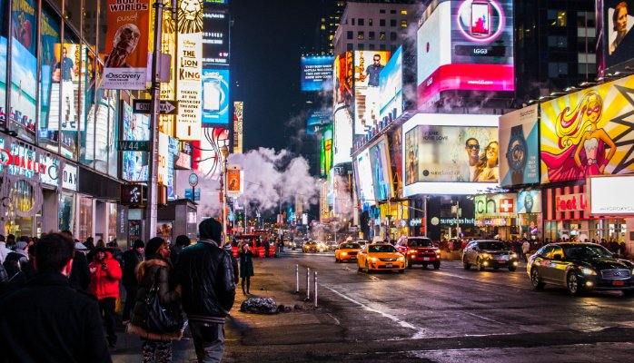
HOT
FLAT
FICKLE
CROWDED
VOLATILE
AMBIGUOUS
CHANGING
CONNECTED

Slide 2
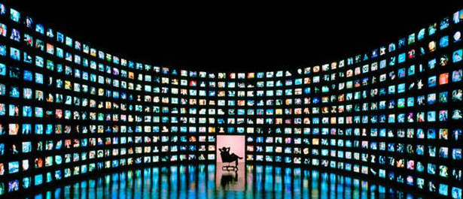
INVESTORS
CUSTOMERS
HAVE MORE CHOICES
THAN EVER
INFLUENCERS
EMPLOYEES

Slide 3
TECHNOLOGY
HAS MADE IT
A LEVEL
PLAYING FIELD
FOR EVERYONE

Slide 4
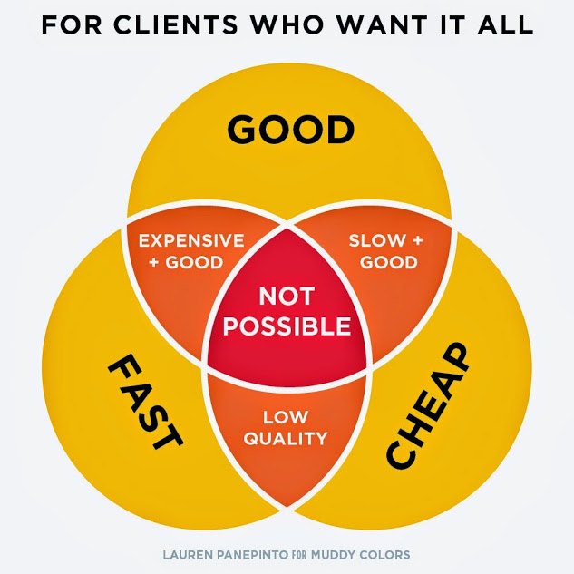

Slide 5
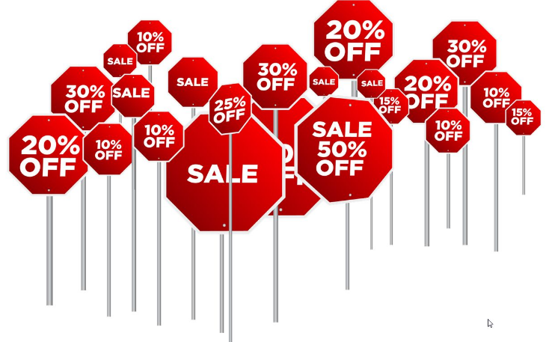

Slide 6
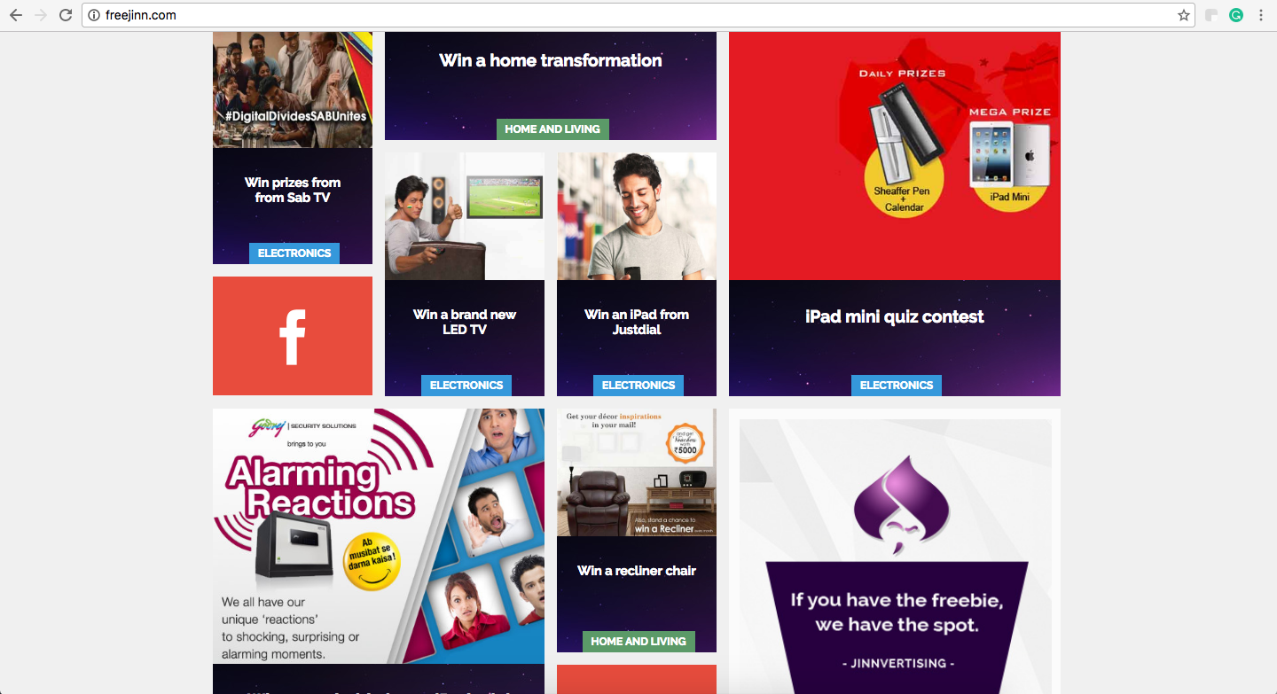

Slide 8
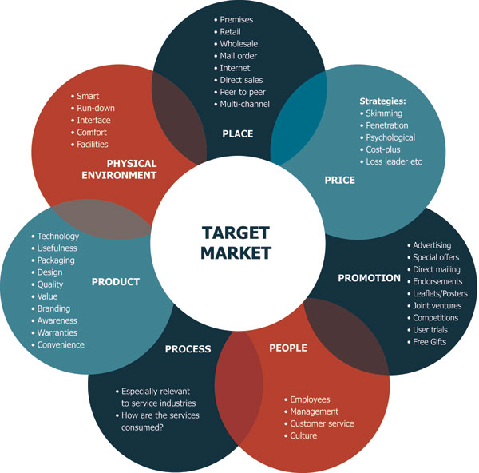
?
360 / 365 / 24 / 7

Slide 9
BRAND
MISSIONARIES
LOYALISTS
ADVOCATES
INFLUENCERS
EVANGELISTS

Slide 10
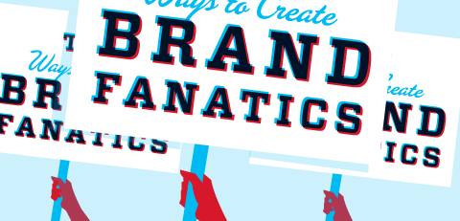

Slide 11
TOP DOWN / ONE TO MANY / SCALE
LINEAR
IMPRESSION
DRIVEN
COMPANY
CENTRIC
Traditional
Messaging about company and products
MESSAGING
ADS
Little knowledge about consumer
To increase brand consideration
A FANATIC
FRAMEWORK
BRAND
ACTS
NARRATIVE
To build trust
Personalisation with customer
USER
CENTRIC
DATA
DRIVEN
ITERATIVE
Dialogue with customer
Contemporary
BOTTOM UP / ONE TO ONE / CONNECTED

Slide 12
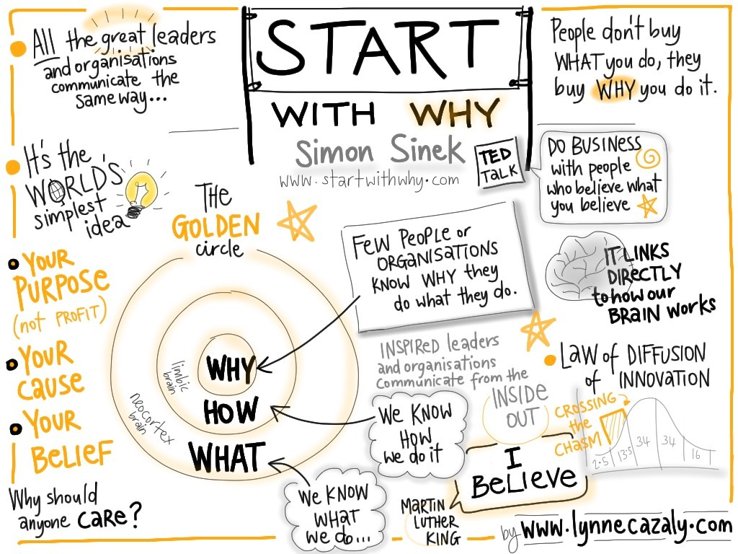

Slide 14
ORIGINAL
BRAND
PURPOSE
RELEVANT
BRAND
IDEAS
INFLUENTIAL
BRAND
EXPERIENCE
ROI
FANATIC
BRAND
Fanatic brands appeal
to the heart and mind, creating an emotional
as well as a functional relationship.
This goes beyond messaging.
This creates a platform for meaningful conversations and interactions. A place where business and customer beliefs meet.
Fanatic brands create value when the data and lessons learnt from the always on bottom-up ideas feed into the traditional top down ideas and vice versa.
This goes beyond pushing a product.
This builds trust and
a meaningful relationship with existing and potential customers.
Fanatic brands are judged by their acts and the experience they provide basis their brand purpose and not just their ads.
This goes beyond the marketing function.
This requires commitment to support the cultural shift across functions and departments creating loyalty and advocacy.
Hunt
Unique visitors
Value per visit
Fans / followers
Farm
Leads / conversion rate
Time on site
Shares / comments / likes
Sell
Sales (online / offline influence)
Revenue / profit
Average order value
Love
Repeat purchase (LVC)
Satisfaction & loyalty
Advocacy

Slide 16
DROPOUTS
PEOPLE
PLANET
CONSIDER
ADVOCATE
PAID
OWNED
FANATIC
LOOP OF
LOVE
INFLUENTIAL
BRAND
EXPERIENCE
BOND
RELEVANT
BRAND
IDEAS
ENJOY
PRODUCTS
PROCESSES
BUY
EARNED
SOCIAL
SAMPLE
EVALUATE

Slide 17
STRATEGISTS
STORYTELLERS
DESIGNERS
INFLUENCERS
CURATORS
A RETAINER TABLE FOR YOUR BRAND
WITH THE RIGHT MIX OF FANATICS
TO MANAGE, PLAN, DESIGN, WRITE,
CODE AND OPTIMIZE BRAND LOVE.
TECHIES
DATA SCIENTISTS
LAWYERS
PRODUCERS

Slide 18
We are Fanatics with a cause
For brands with a purpose
/ KarlGomes
+91-9004049531

